Slide 1
Section R.2
Algebra Essentials
Copyright © 2012 Pearson Education, Inc. Publishing as Prentice Hall.

Slide 2
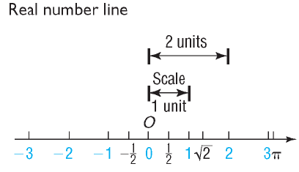
Copyright © 2012 Pearson Education, Inc. Publishing as Prentice Hall.

Slide 3
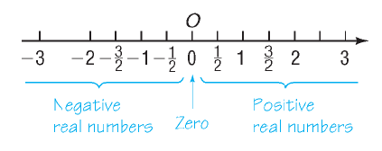
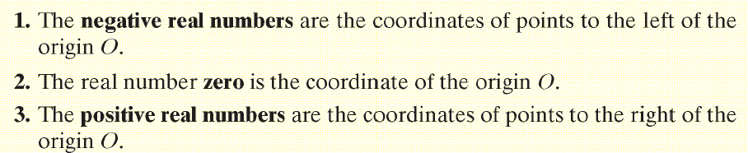
Copyright © 2012 Pearson Education, Inc. Publishing as Prentice Hall.

Slide 4
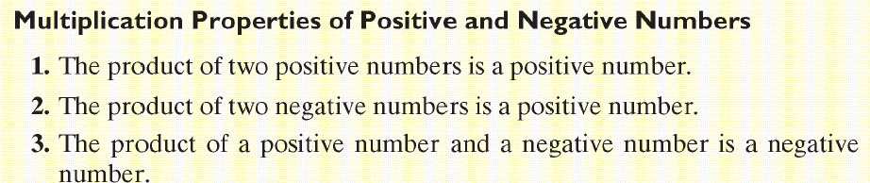
Copyright © 2012 Pearson Education, Inc. Publishing as Prentice Hall.

Slide 5

Copyright © 2012 Pearson Education, Inc. Publishing as Prentice Hall.

Slide 6
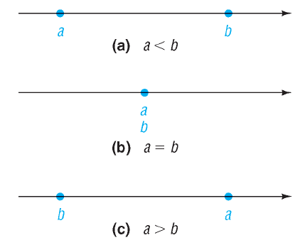
Copyright © 2012 Pearson Education, Inc. Publishing as Prentice Hall.

Slide 7


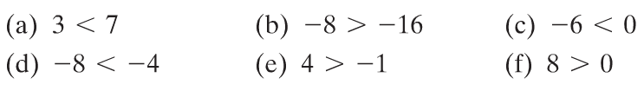

Copyright © 2012 Pearson Education, Inc. Publishing as Prentice Hall.

Slide 8




Copyright © 2012 Pearson Education, Inc. Publishing as Prentice Hall.

Slide 9

Copyright © 2012 Pearson Education, Inc. Publishing as Prentice Hall.

Slide 10
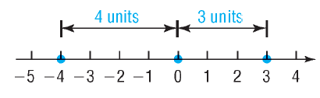
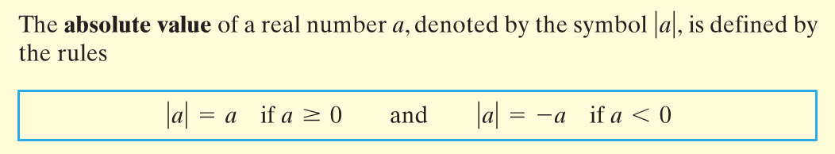
Copyright © 2012 Pearson Education, Inc. Publishing as Prentice Hall.

Slide 11



Copyright © 2012 Pearson Education, Inc. Publishing as Prentice Hall.

Slide 12
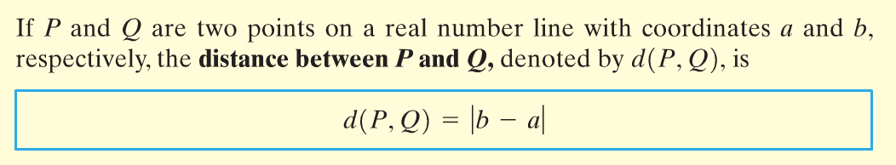
Copyright © 2012 Pearson Education, Inc. Publishing as Prentice Hall.

Slide 13
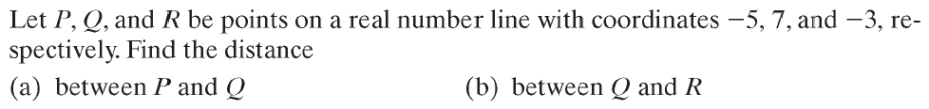
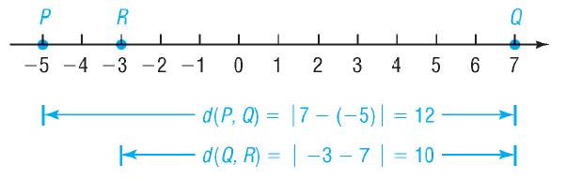

Copyright © 2012 Pearson Education, Inc. Publishing as Prentice Hall.

Slide 14

Copyright © 2012 Pearson Education, Inc. Publishing as Prentice Hall.

Slide 15
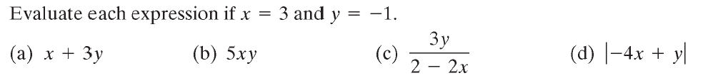
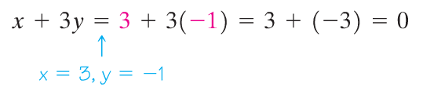


Copyright © 2012 Pearson Education, Inc. Publishing as Prentice Hall.

Slide 16
Copyright © 2012 Pearson Education, Inc. Publishing as Prentice Hall.

Slide 17

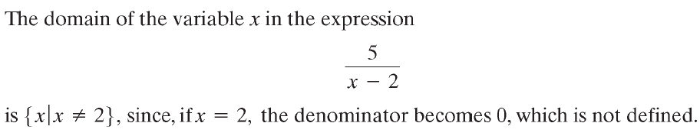
Copyright © 2012 Pearson Education, Inc. Publishing as Prentice Hall.

Slide 18

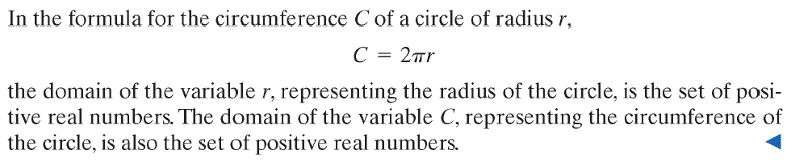
Copyright © 2012 Pearson Education, Inc. Publishing as Prentice Hall.

Slide 19

Copyright © 2012 Pearson Education, Inc. Publishing as Prentice Hall.

Slide 20
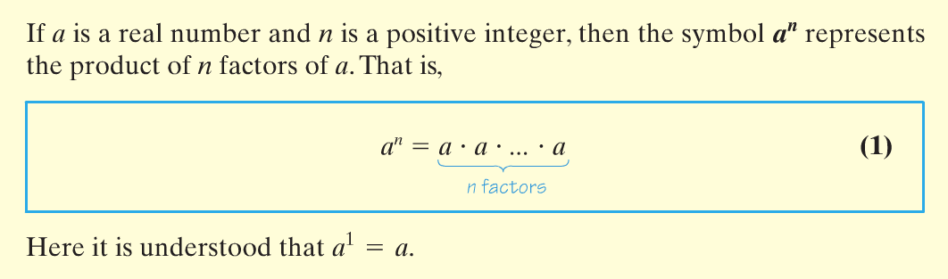


Copyright © 2012 Pearson Education, Inc. Publishing as Prentice Hall.

Slide 21




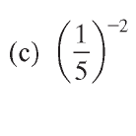
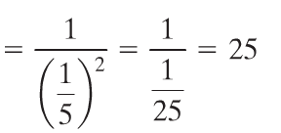
Copyright © 2012 Pearson Education, Inc. Publishing as Prentice Hall.

Slide 22

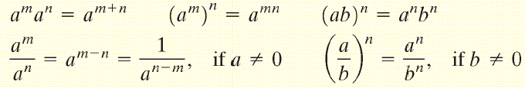

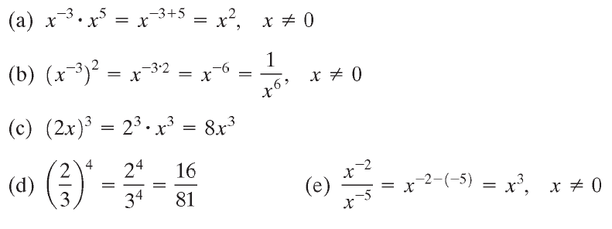





Copyright © 2012 Pearson Education, Inc. Publishing as Prentice Hall.

Slide 23

Copyright © 2012 Pearson Education, Inc. Publishing as Prentice Hall.

Slide 24
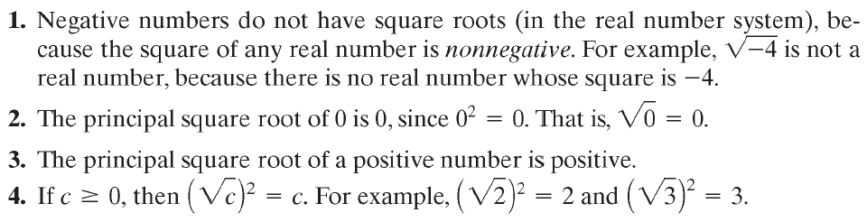
Copyright © 2012 Pearson Education, Inc. Publishing as Prentice Hall.

Slide 25

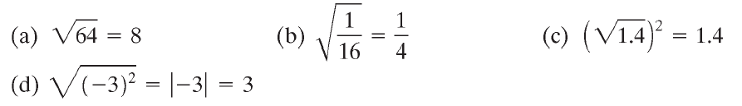



Copyright © 2012 Pearson Education, Inc. Publishing as Prentice Hall.

Slide 26


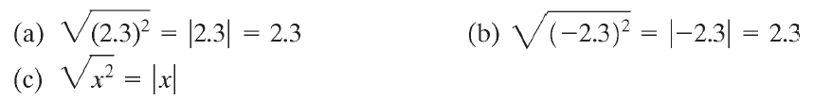



Copyright © 2012 Pearson Education, Inc. Publishing as Prentice Hall.

Slide 27
Copyright © 2012 Pearson Education, Inc. Publishing as Prentice Hall.

Slide 28

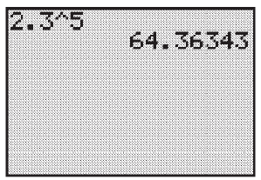
Copyright © 2012 Pearson Education, Inc. Publishing as Prentice Hall.

Slide 29

Copyright © 2012 Pearson Education, Inc. Publishing as Prentice Hall.

Slide 30
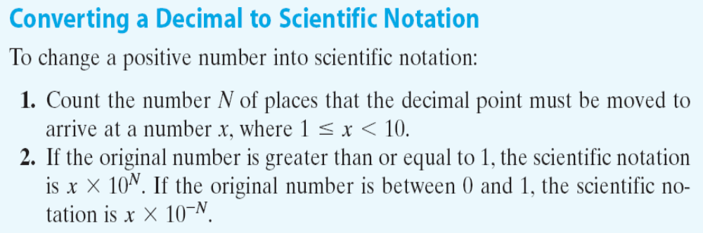
Copyright © 2012 Pearson Education, Inc. Publishing as Prentice Hall.

Slide 31


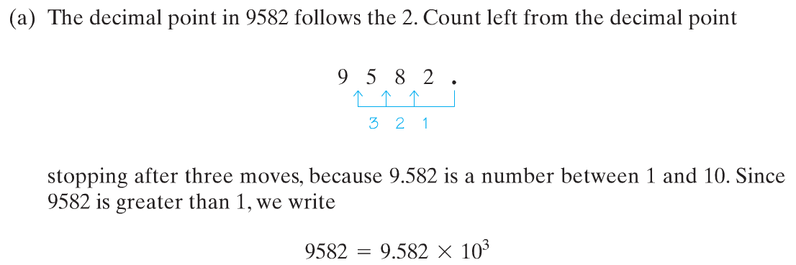
Copyright © 2012 Pearson Education, Inc. Publishing as Prentice Hall.

Slide 32
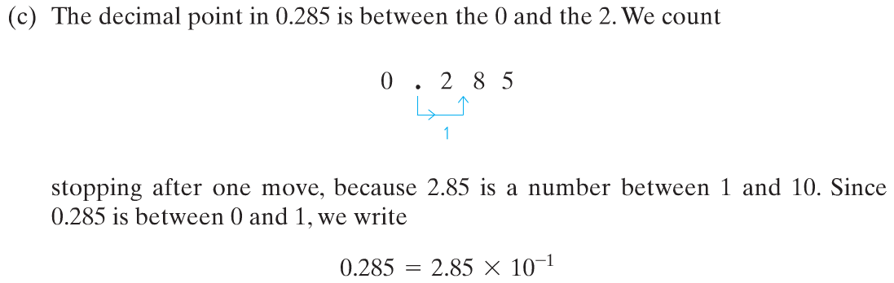
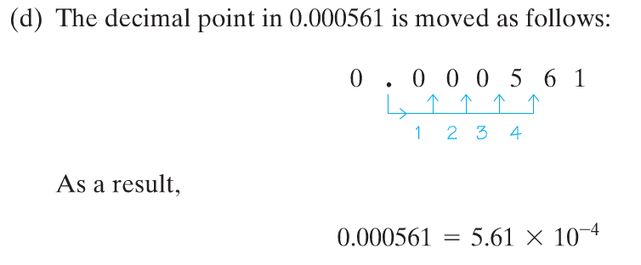
Copyright © 2012 Pearson Education, Inc. Publishing as Prentice Hall.

Slide 33

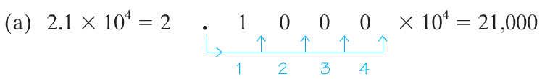
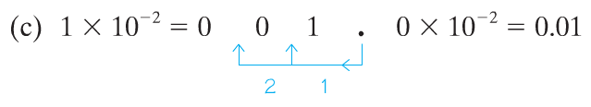
Copyright © 2012 Pearson Education, Inc. Publishing as Prentice Hall.

Slide 34

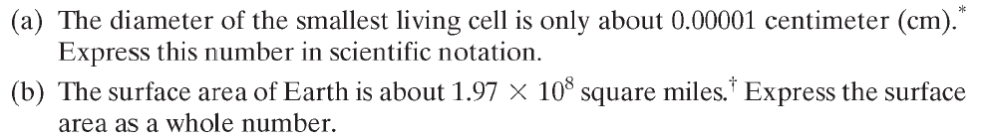
Copyright © 2012 Pearson Education, Inc. Publishing as Prentice Hall.

